Slide 1


BORCELLE
Home
Photo
About Us
Contact
https://www.spyrix.com/
KEYLOGGER

Slide 2

BORCELLE
Home
Photo
About Us
Contact
ABOUT keylogger
A keylogger can be special hardware or software that can record keystrokes as you type on a keyboarA keylogger can be special hardware or software that can record keystrokeA keylogger can be special hardware or software that can record keystrokes as you type on a keyboard. You will be able to see passwords and usernames to various accounts (i.e bank accounts, email, etc), google earches, conversations that can be used to extort money or more information from a target, etc. Cybercriminals create fake websites or send an email embedding the keylogger in a malicious link or in a downloadable attachment known as a phishing attack.

Slide 3
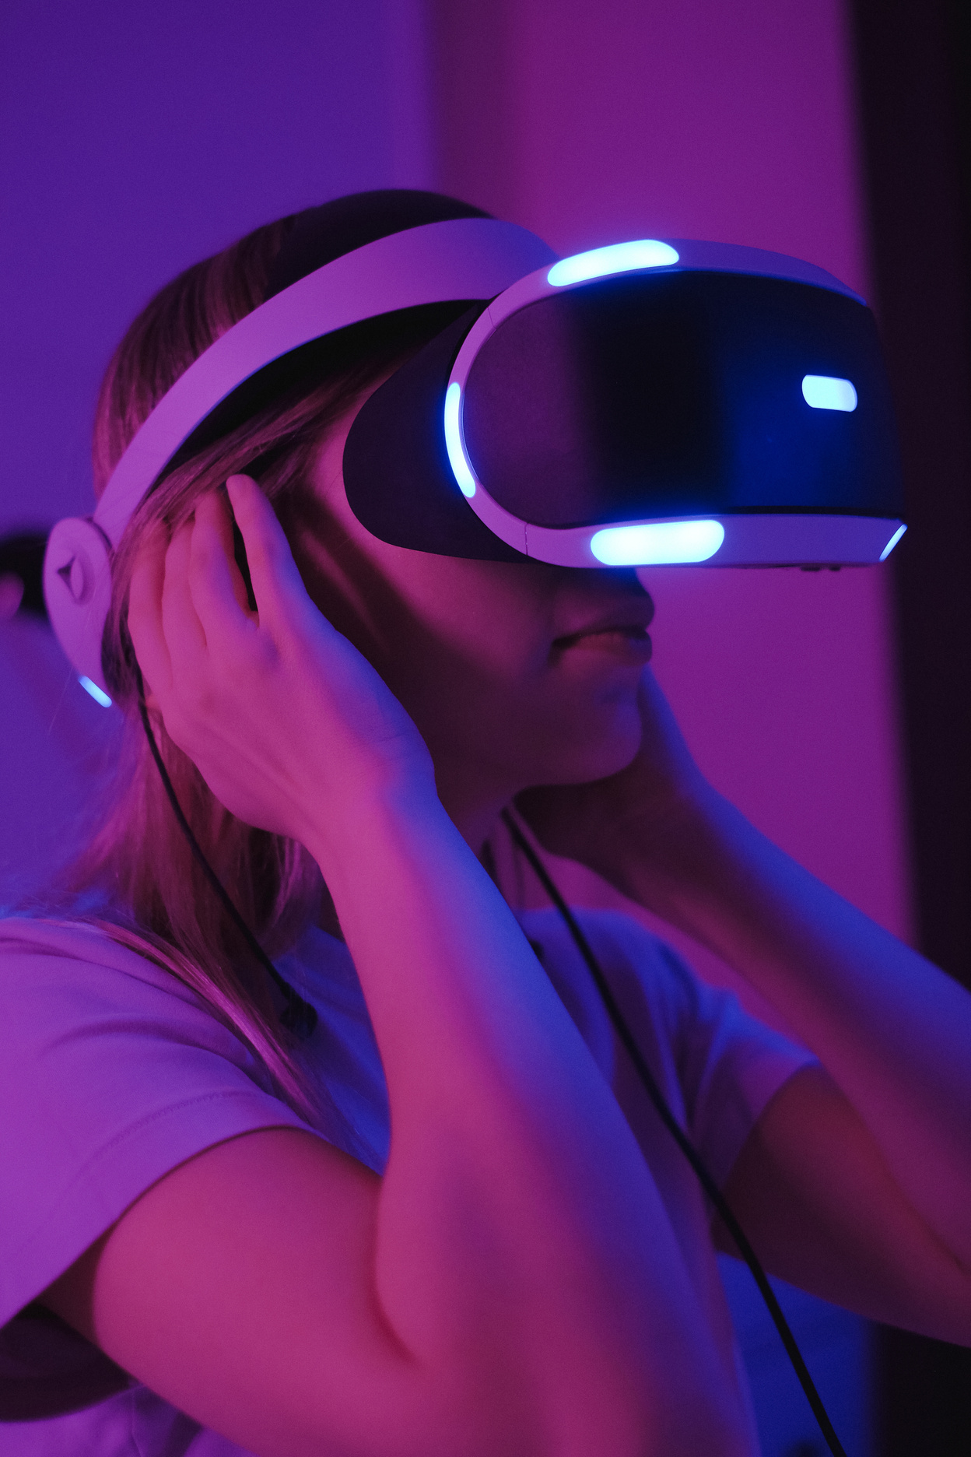
BORCELLE
Home
Photo
About Us
Contact
OUR PROJECT
keyloggers can be detected, but the method depends on the type of keylogger:
HARDWARE KEYLOGGERS:
They can be easily detected. A hardware-based keylogger is a tiny device, a physical component that connects to the computer via the keyboard. The device usually looks like a standard keyboard PS/2 connector, computer cabling, or a USB adaptor, making it relatively simple to conceal the device for someone who wants to keep an eye on a user’s behavior.
SOFTWARE KEYLOGGERS:
They can be hard to detect. A software-based keylogger is a computer program that can be installed without having direct access to the user’s computer. It can be downloaded on purpose by someone who wants to monitor a computer, or it can be downloaded without the user’s knowledge and run as part of a rootkit or a remote administration Trojan (RAT).

Slide 4
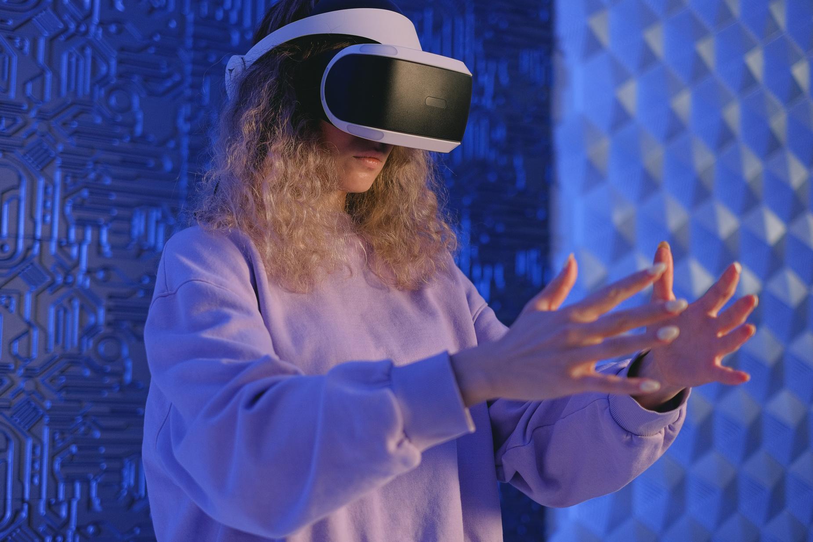



BORCELLE
Home
Photo
About Us
Contact
The project is focused on addressing the cybersecurity threat posed by keyloggers. It aims to develop and implement detection and mitigation strategies to safeguard sensitive data. The project will involve in-depth research on keylogger behavior, vulnerability identification, deployment of advanced security measures, and user education on data protection. The overarching objective is to bolster cybersecurity resilience and minimize the impact of keyloggers on data security.
PROJECT OVERVIEW
01
For this Project we need to make sure to install two packages:
First one is pip pynput install.(pip install pynput)
Next one is johns library.(pip install johns lib)
02

Slide 5

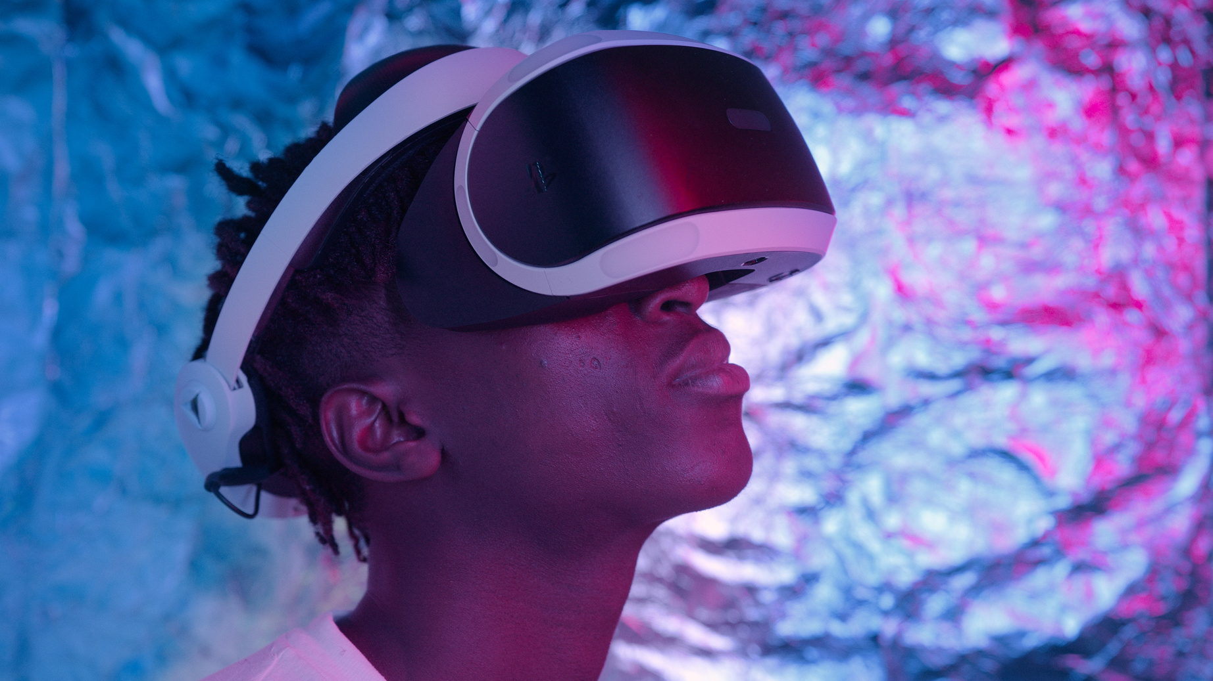

BORCELLE
Home
Photo
About Us
Contact
WHO ARE THE END USERS ?
Parents may use keyloggers to monitor their children's online activities to protect them from online predators, cyberbullying, or inappropriate content.
01
Researchers might use keyloggers in controlled environments to study their behaviors and develop countermeasures against malicious keyloggers.
02
Some government agencies use keyloggers for surveillance and to gather evidence in investigations involving terrorism, cybercrime, or other serious offenses.
03

Slide 6
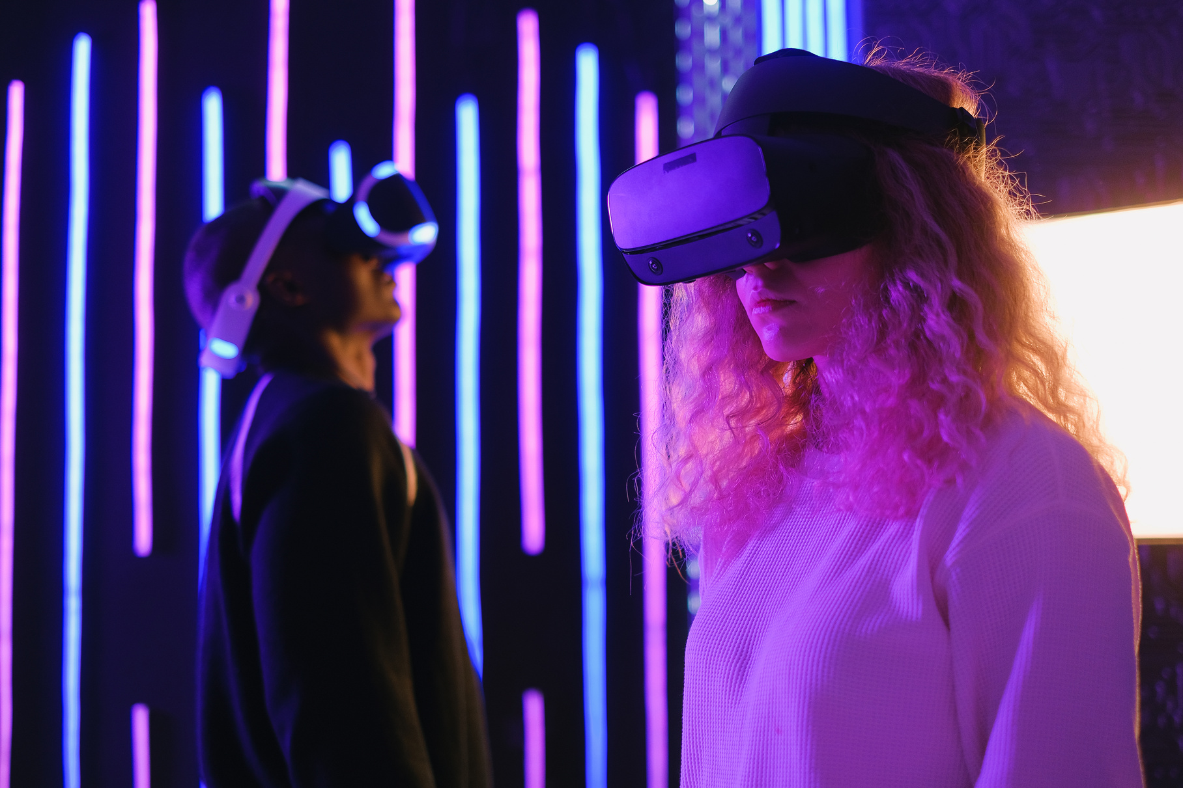
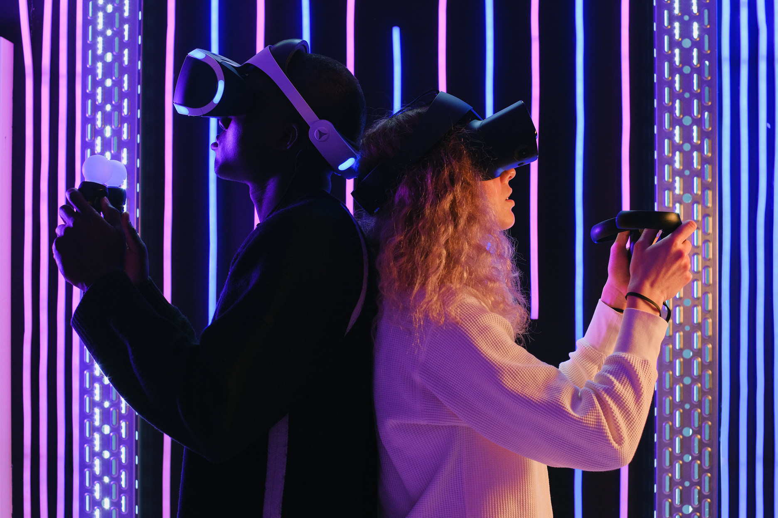
BORCELLE
Home
Photo
About Us
Contact
OUR MISSION
Real-Time Detection:
Utilizes machine learning algorithms to identify suspicious activities instantly.
01
User-Friendly Interface:
Simple, intuitive design ensuring ease of use for all user levels.
02

Slide 7
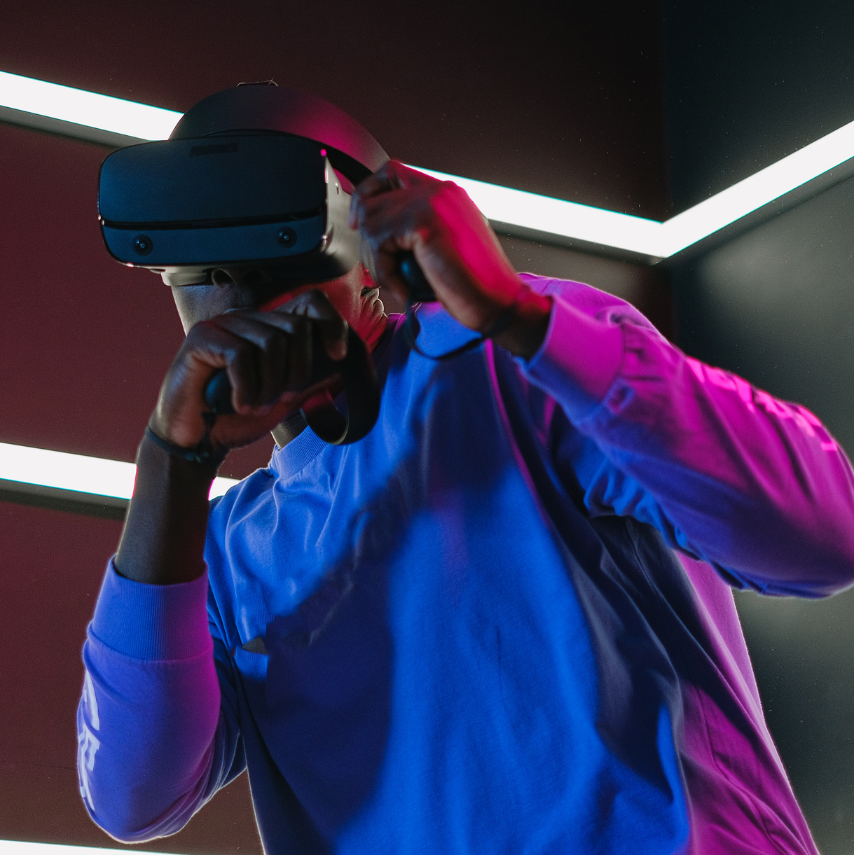

BORCELLE
Home
Photo
About Us
Contact
THE WOW IN THE SOLUTION
Our solution's wow factor is the proactive implementation of robust detection and mitigation measures, which ensures the safeguarding of sensitive data and significantly reduces the risk of unauthorized access to critical information. This approach elevates cybersecurity resilience, providing a substantial boost in overall data security.

Slide 8
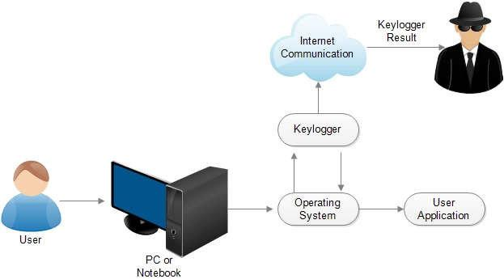
MODELLING

Slide 9
Home
Photo
About Us
Contact
Student Name
BHAVYA SRI BAGGI

Slide 10

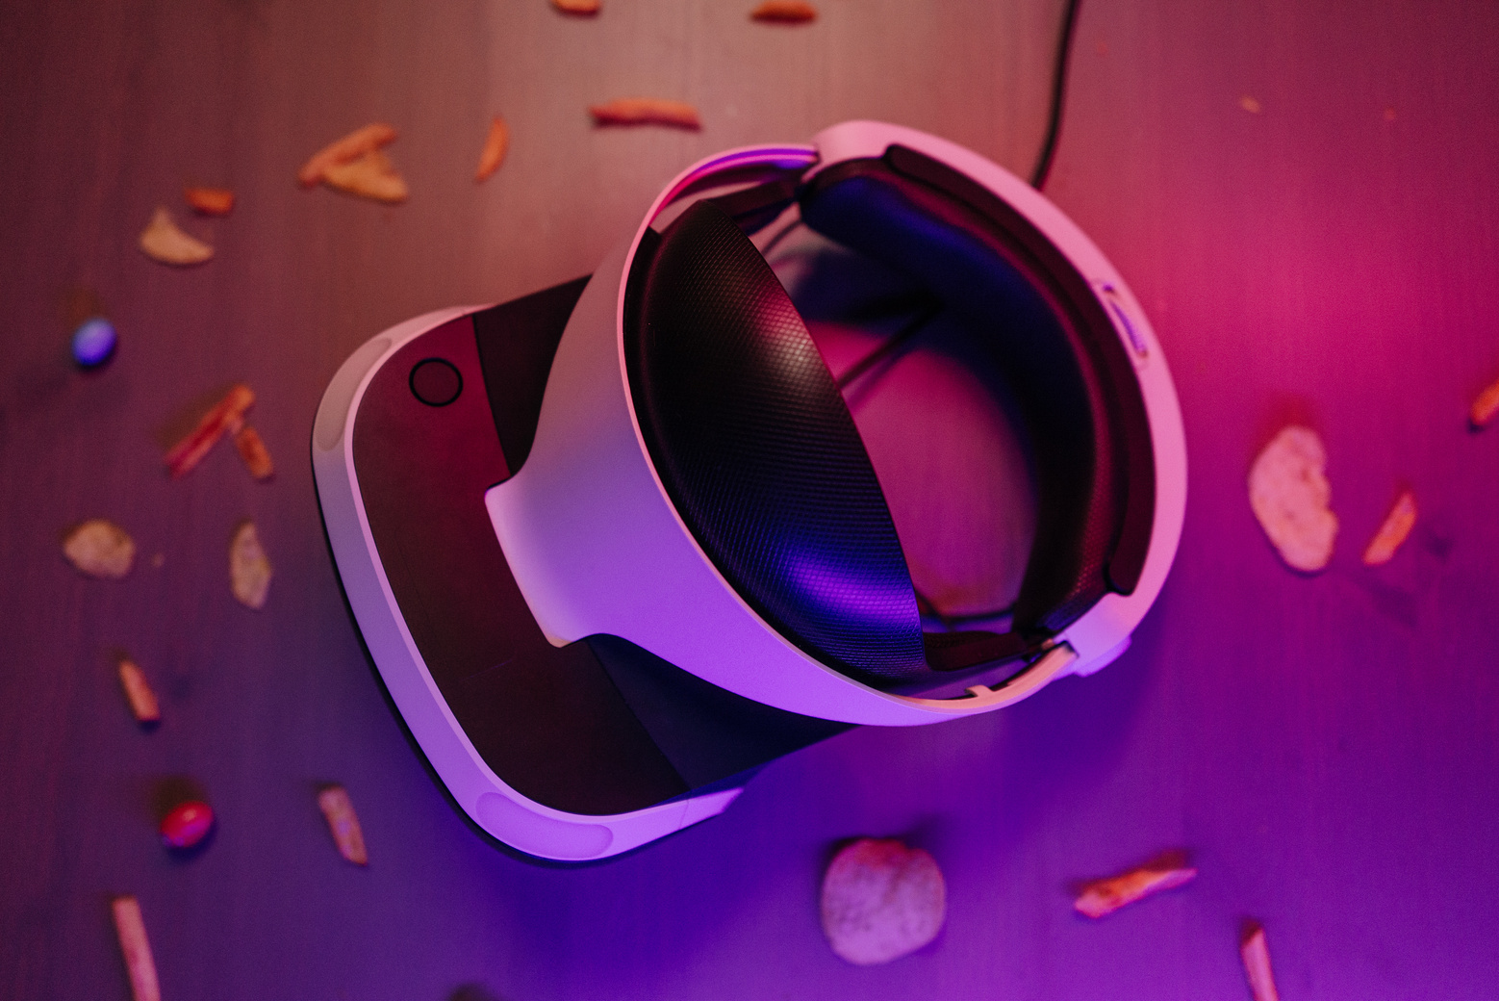

BORCELLE
Home
Photo
About Us
Contact
CONTACT
https://github.com/Bhavyasri-Baggi/CSIBM.git
bhavyabaggi407@gmail.com

Slide 11
BORCELLE
Home
Photo
About Us
Contact
https://www.spyrix.com/
THANK YOU

